Slide 1
Evidence for an Explosive Origin of Central Pit Craters on Mars
Nathan R. Williams, James F. Bell III,
Philip R. Christensen, Jack D. Farmer
Arizona State University
Dec. 11, 2013

Slide 2
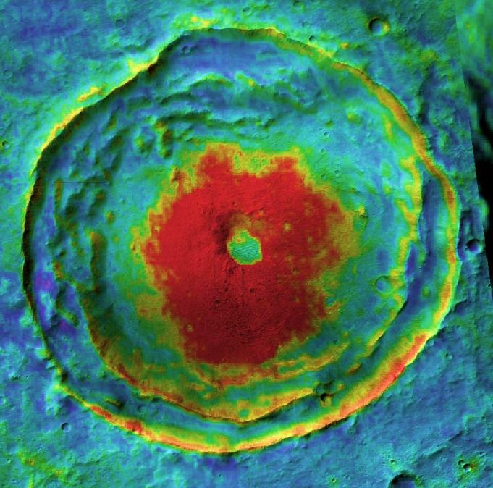
Overview
Introduction
Hypotheses
Methodology
Results
Discussion
Energetic Plausibility
Conclusions
Warm
Cool
N
5 km
18.4°S, 102.7°E
A central pit crater via THEMIS nighttime IR mosaic (color) over CTX visible images (shading)

Slide 3
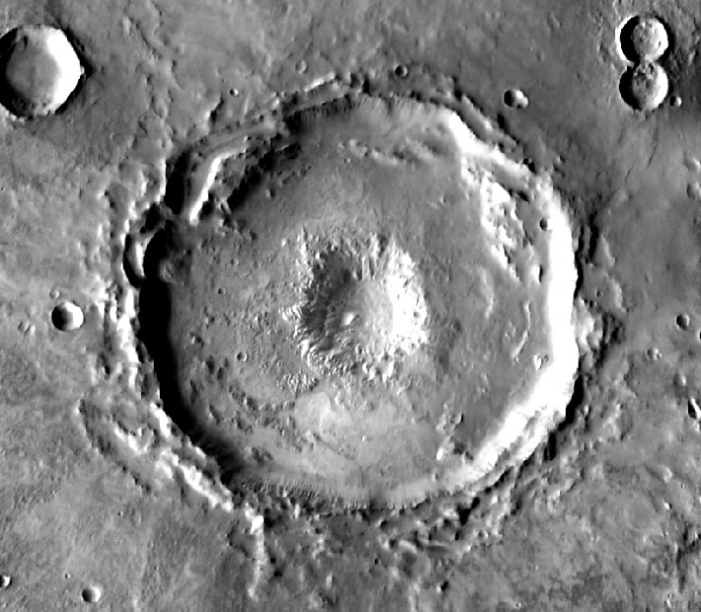
Introduction
Kilometer-scale pit craters nested in centers of some impact craters
Commonly occur on Mars and icy satellites including Ganymede and Callisto
Rare on Mercury and the Moon
Relationship with water/ice inferred
Process(es) responsible are still debated
N
10 km
18.4°S, 102.7°E
VE=5x
THEMIS daytime IR mosaic of a central pit crater and MOLA topographic profile

Slide 4
Hypotheses for Pit Formation
Drainage and Collapse
Impact into icy substrate
Impact fractures target
Liquid water drains through fractures
Void space collapses
Analogs: sinkholes, karst, calderas, skylights
e.g.: Croft, 1981; Passey and Shoemaker, 1982; Barlow, 2011; Alzate and Barlow, 2011; Elder et al., 2012; Bray et al., 2012
LROC NAC images of rimless collapse pit on the Moon (Robinson et al., 2012). Images approx. 175 m wide

Slide 5
Hypotheses for Pit Formation
Explosive Excavation
Impact into icy substrate
Steam explosion
Material in pit ejected
Ejecta deposited around/near pit
Analogs: maars, impacts, nuclear explosions
e.g.: Wood et al., 1978; Hodges, 1978; Hodges et al., 1980; Greeley et al., 1982; Barlow, 2006, 2010
Aerial oblique image of the analogous 300 m diameter Ukinrek maar volcano and its ejecta.
Photograph by C. Nye, Alaska Division of Geological and Geophysical Surveys, 1994
Ejecta is only expected for explosive scenario

Slide 6
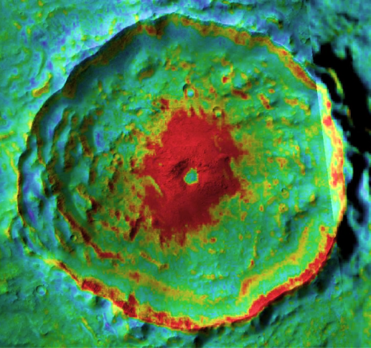
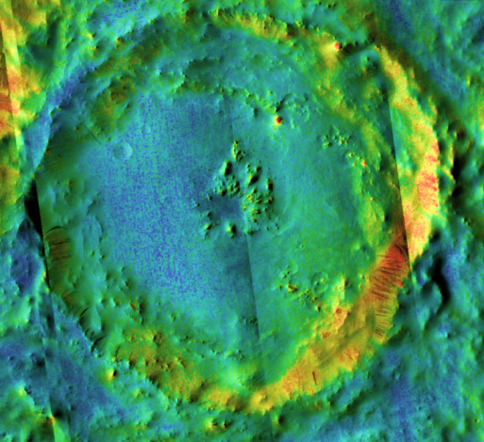
Methodology
Warm
Cool
Survey central pit craters ±60° lat. for evidence of pit ejecta in JMARS
Blocky material distinctively warm in nighttime thermal images*
Use THEMIS daytime IR mosaic and CTX images to identify central pits
Use THEMIS nighttime IR mosaic to identify annulus or skewed patch of blocky debris
N
14.7°S, 93.2°E
5 km
Warm
Cool
N
10 km
*(Christensen, 1986; Edwards et al., 2009;
McEwen et al., 2005; Tornabene et al., 2006)
10.9°N, 50.8°E
THEMIS nighttime IR mosaic over CTX images of central pit craters with (top) and without (bottom) warm material.

Slide 7
Survey Results
Pits w/ Warm Material (n=388, 59.3%)
Pits w/o Warm Material (n=266, 40.7%)

Slide 8
Results: Size Distribution
Warm (blocky) material around most pits
Median parent crater diameter w/ warm pit material: 24 km
Median parent crater diameter w/o warm pit material: 17 km
Larger craters/pits more likely to show warm material

Slide 9
Results: Albedo Distribution
Albedos around pits measured with Thermal Emission Spectrometer
Distribution reflects bimodal distribution of dust on Mars
Pits in dusty areas tend not to show warm (blocky) material
Notes:
Median albedo (non-dusty region)
Anomaly
0.14
(n=254, 70%)
No anomaly
0.14
(n=106, 30%)
Median albedo (dusty region)
Anomaly
0.236
(n=134,46%)
No anomaly
0.267
(n=160, 54%)

Slide 10
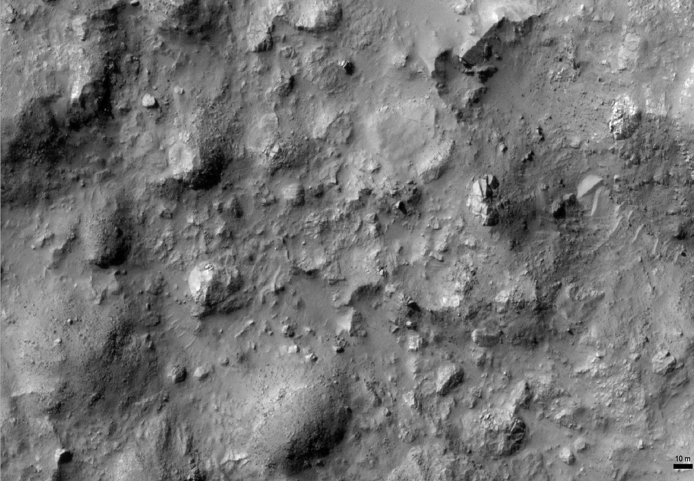
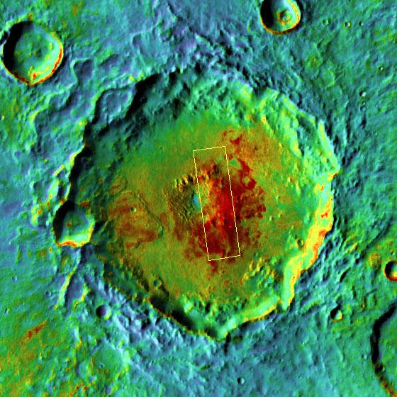
Results: Morphology
CTX, HiRISE images show large (meter to decimeter scale) blocks associated with warm nighttime temperatures
Warm
Cool
N
10 km
N
50 m
PSP_007897_1560_RED
HiRISE image (left) showing blocky material in THEMIS warm patch (right) around central pit at 23.8°S, 126.8°E.

Slide 11
Results: Morphology
Raised rims also identified around many central pits as early as Hodges (1978)
SW
NE
Raised Pit Rims
VE=10x
N
10 km
MOLA topographic profile across a central pit crater at 18.4°S, 102.7°E, showing raised rims around both the pit and parent crater.

Slide 12
Discussion
Smaller pits’ ejecta finer-grained, and more easily eroded or buried
Dust deposits several centimeters thick mask diurnal thermal variation
Raised rims around many pits likely ejecta
Expected for explosive excavation, not collapse
Preservation of pits indicates formation during or after impact modification phase
Perhaps late-stage phreatomagmatic interaction?
Similar-sized maar craters are observed on Earth (Beget et al., 1996)

Slide 13
Energetic Plausibility of an Explosive Origin
Impact melt estimates for parent crater from O’Keefe and Ahrens (1982)
Pit crater forming energy from Sato and Taniguchi (1997)
Heat transfer efficiencies of 0.1-0.3 from Wohletz (1986)
Estimate volume of craters as half-ellipsoids
Use specific and latent heats for raising ice from 0°C to steam at 100°C; cool basaltic melt from solidus 1200°C to 100°C
More than enough thermal energy available
Need only ~3% water,
~10-25% rock-melt by volume
Notes:
For superheated steam up to 1200C, only requires 1.5% water by volume

Slide 14
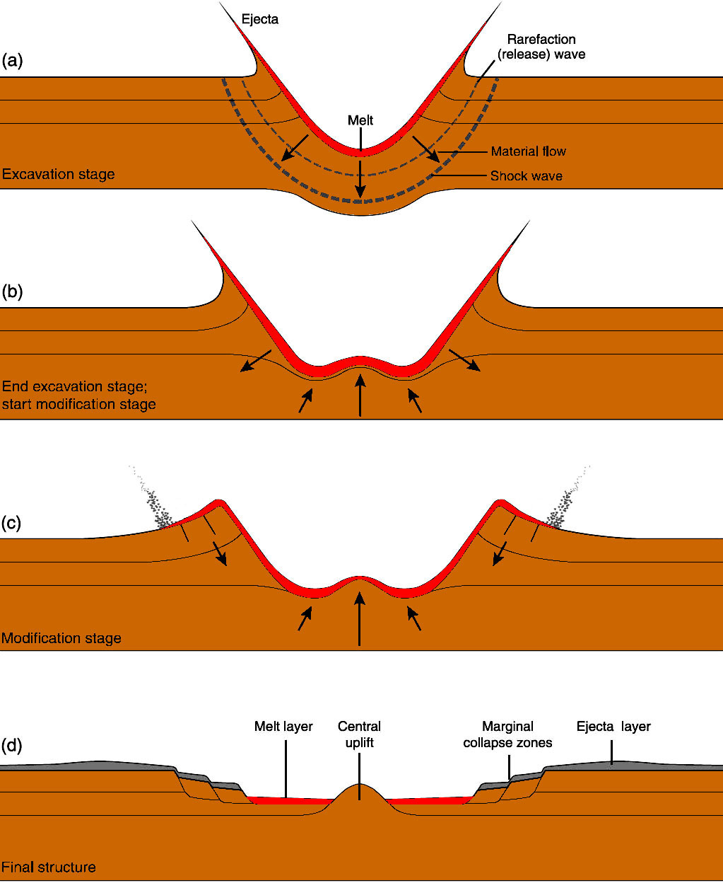
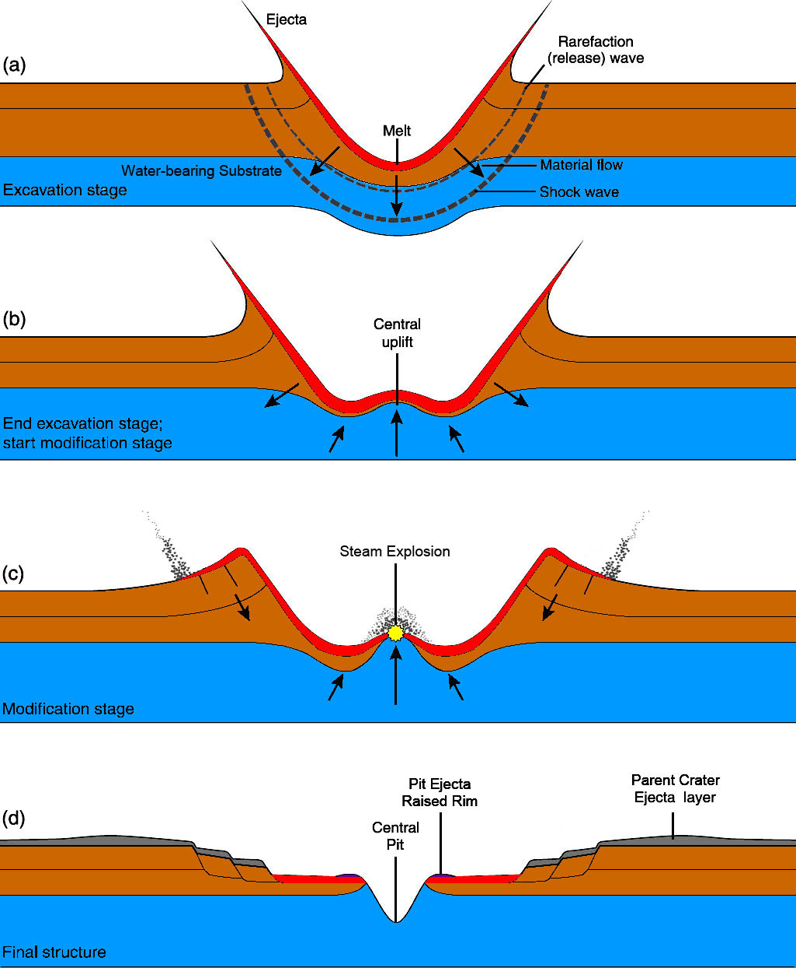
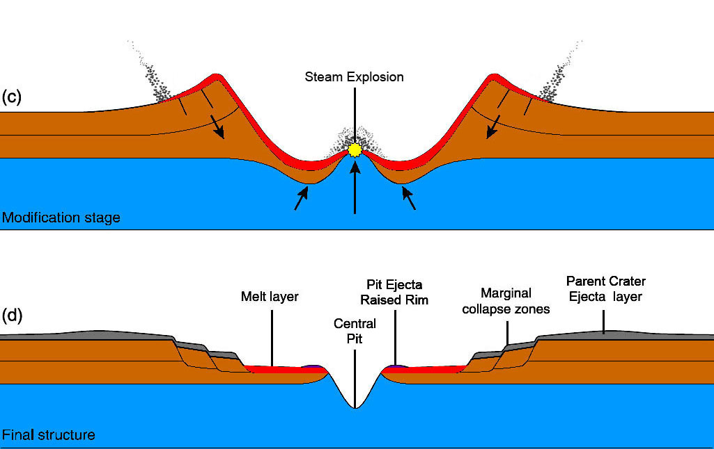
Explosive Scenario
No Explosion
Modified from French (1998)
this study

Slide 15
Conclusions
Blocky debris and raised rims observed surrounding many central pits suggest an explosive origin
Blocky ejecta and raised rims are not expected for collapse structures
More than enough thermal energy already available via impact rock-melt to drive large steam explosions
Explosive excavation requires only ~3% water
Future work and modeling needed to address explosive feasibility on other planets and icy satellites
Explosive origin of central pit craters supported on Mars

Slide 16
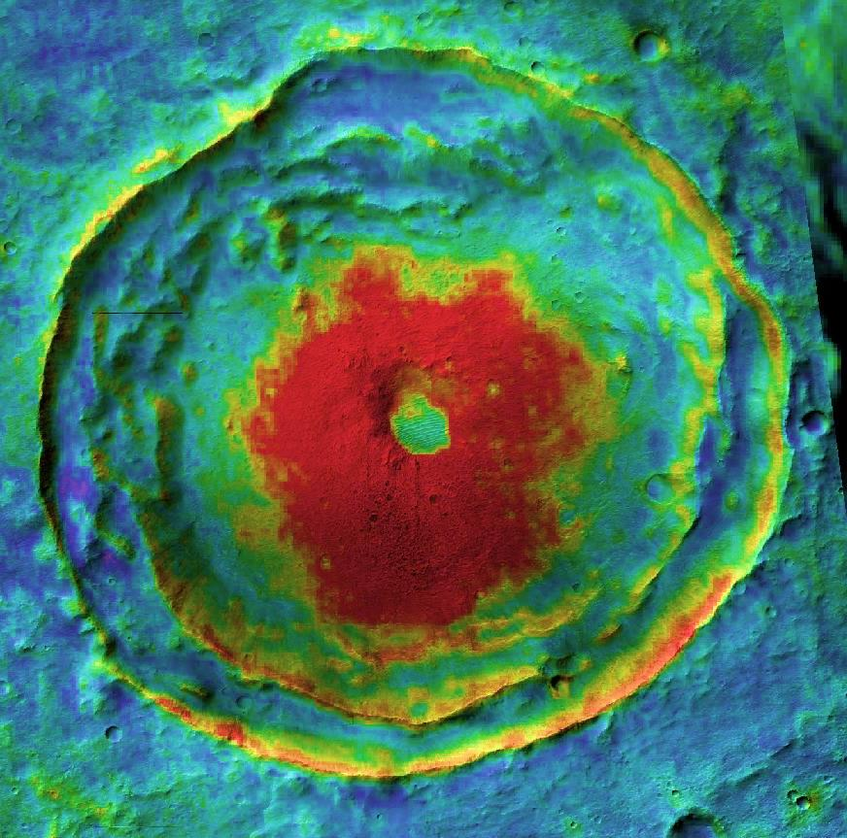
Thank you! Questions?
N
Warm
Cool
18.4°S, 102.7°E
5 km
THEMIS nighttime IR mosaic (color) over CTX visible images (shading)

Slide 17
References
Alzate, N. and N. G. Barlow (2011), Icarus 211, 1274-1283.
Baker, V. R. (1982), The Channels of Mars, 198 pp., University of Texas Press, Austin, Texas.
Baker, V. R. and D. J. Milton (1974), Icarus 23, 27-41.
Baloga, S. M., et al. (2005), JGR 110, E10001, doi:10.1029/2004JE002338.
Barlow, N. G. (2006), Meteoritics & Planetary Science 41, 1425-1436.
Barlow, N. G. (2010), GSA Special Paper 465, 15-27.
Barlow, N. G., et al. (2000), JGR 105, E11, 26733-26738.
Barlow, N. G. (2011), Proc. 42nd LPSC, Abs #1149.
Begét, J. E., et al. (1996), Arctic 49, 1, 62-69.
Bell, J. F., III, et al. (2013), Mars 8, 1-14, doi:10.1555/mars.2013.0001.
Bray, V. J., et al. (2012), Icarus 217, 115-129.
Burr, D. M., et al. (2002), GRL 29, 1, 1013, doi: 10.1029/2001GL013345.
Carr, M. H., et al. (1977), JGR 82, 28, 4055-4065.
Carr, M. H. (1979), JGR 84, B6, 2995-3007.
Christensen, P. R. (1986),, Icarus 68, 217-238.
Christensen, P. R., et al. (2001), JGR 106, E10, 23,823–23,871.
Christensen, P. R., et al. (2009), AGU FM, Abs. #IN22A-06
Christensen, P.R., et al. (2004), Space Science Reviews, 110, 85-130.
Clifford, S. M. and D. Hillel (1983), JGR 88, B3, 2456-2474.
Croft, S. K. (1981), Proc. 12th LPSC, 196-198.
Cushing, G. E., et al. (2007), GRL 34, L17201, doi:10.1029/2007GL030709.
Edwards, C. S., et al. (2009), JGR 114, E11001, doi:10.1029/2009JE003363.
Edwards, C. S., et al. (2011), JGR 116, E10008, doi:10.1029/2010JE003755.
Elder, C.M., et al. (2012), Icarus 221, 831-843.
Fergason, R.L., et al. (2006), JGR., 111, E12004, doi:10.1029/2006JE002735.
French, B. M. (1998), Traces of Catastrophe, LPI Contribution No. 954, Lunar and Planetary Institute, Houston. 120 pp.
Gault, D. E. and R. Greeley (1978), Icarus 34, 486-495.
Greeley, R., et al. (1982), in D. Morrison (Ed.), Satellites of Jupiter, pp. 340-378.
Grieve, R. A. F., et al. (2010), Meteoritics and Planetary Science 45, 5, 759-782.
Head, J. W., et al. (2003),, Nature 426, 797-802.
Hodges, C. A. (1978), Proc. 9th LPSC, 521-522.
Hodges, C. A., et al. (1980), Proc. 11th LPSC, 450-452.
Malin, M. C., et al. (2007), JGR 112, E05S04, doi:10.1029/2006JE002808.
McEwen, A. S., et al. (2005), Icarus 176, 351-381.
McEwen, A. S., et al. (2007), JGR 112, E05S02, doi:10.1029/2005JE002605.
McKenzie, D., and F. Nimmo (1999), Nature 397, 231-233.
Mellon, M. T., et al. (1997), JGR 102, E8, 19357-19369.
Melosh, H. J. (1989), Impact Cratering: A Geologic Process, Oxford Monographs on Geology and Geophysics #11, Oxford University Press, New York.
O’Keefe, J. D. and T. J. Ahrens (1985), Icarus 62, 328-338.
Okubo, C. H. and S. J. Martel (1998), Journal of Volcanology and Geothermal Research 86, 1-18.
Passey, Q. R. and E. M. Shoemaker (1982), In: Morrison, D. (Ed.), Satellites of Jupiter. Univ. of Arizona Press, Tucson, pp. 340–378.
Robinson, M. S., et al. (2012), Planetary and Space Science 69, 18-27.
Salvati, R. and I. D. Sasowsky (2002), Journal of Hydrology 264, 1-11.
Sato, H. and H. Taniguchi (1997), GRL 24, 3, 205-208.
Smith, E. I. (1976), Icarus 28, 543-550.
Smith, B. A., et al. (1979), Science 206, 927-950.
Smith, D. E., et al. (2001), JGR 106, E10, 23689-23722.
Tornabene, L. L., et al. (2006), JGR 111, E10006, doi:10.1029/2005JE002600.
Xiao, Z. and G. Komatsu (2013), Plan. and Space Sci., DOI: 10.1016/j.pss.2013.03.015.
Wohletz, K. H. and M. F. Sheridan (1983), Icarus 56, 15-37.
Wohletz, K. H. (1986), Bull. Volcanol. 48, 245-264.
Wood, C.A., et al. (1978), Proc. 9th LPSC, 3691-3709.

Slide 18
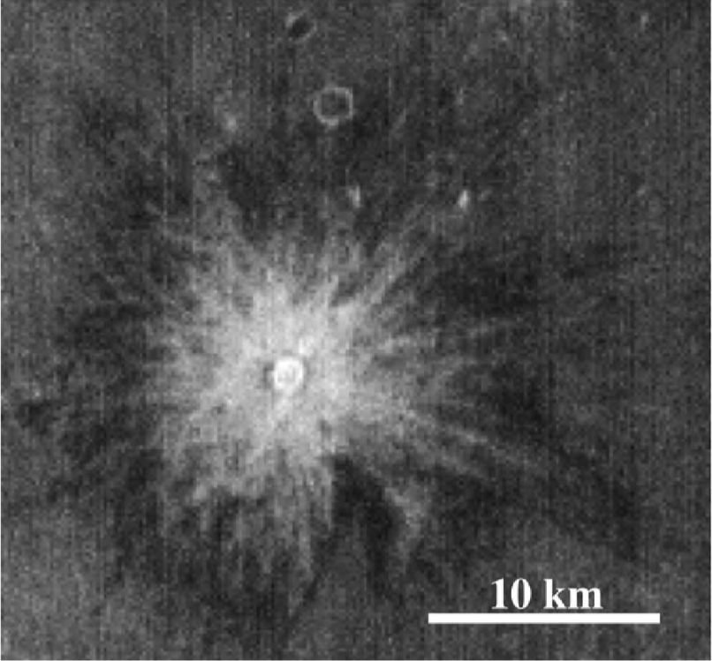
Blocky Crater Ejecta in THEMIS Nighttime Images
Impact crater Zunil (McEwen et al., 2005)

