Slide 1
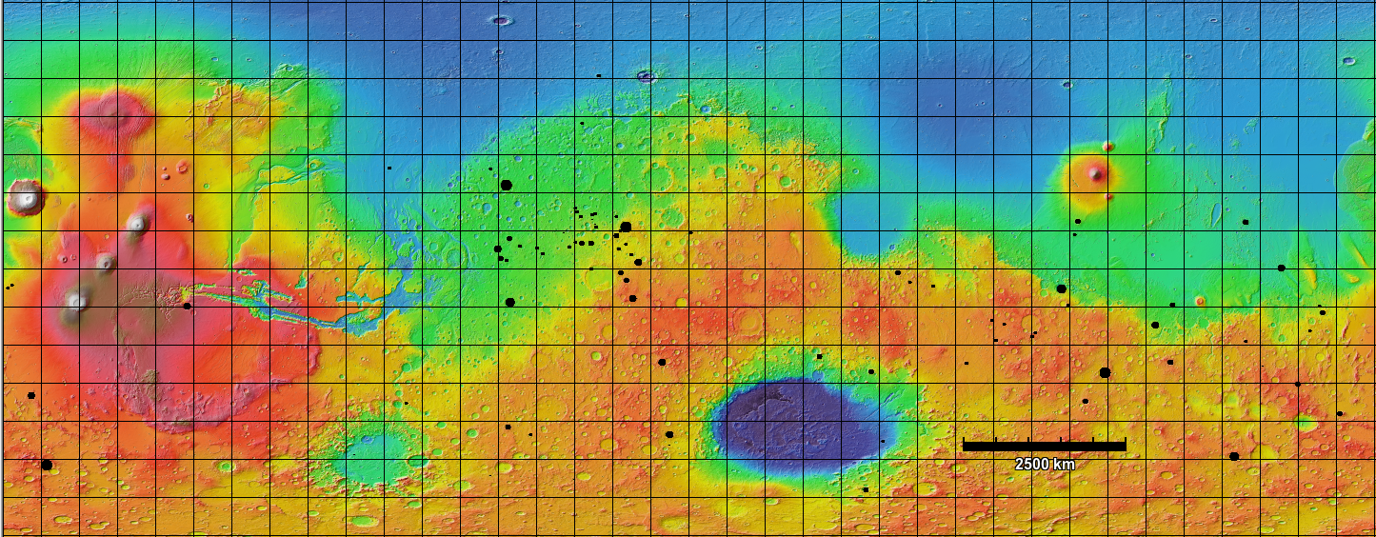
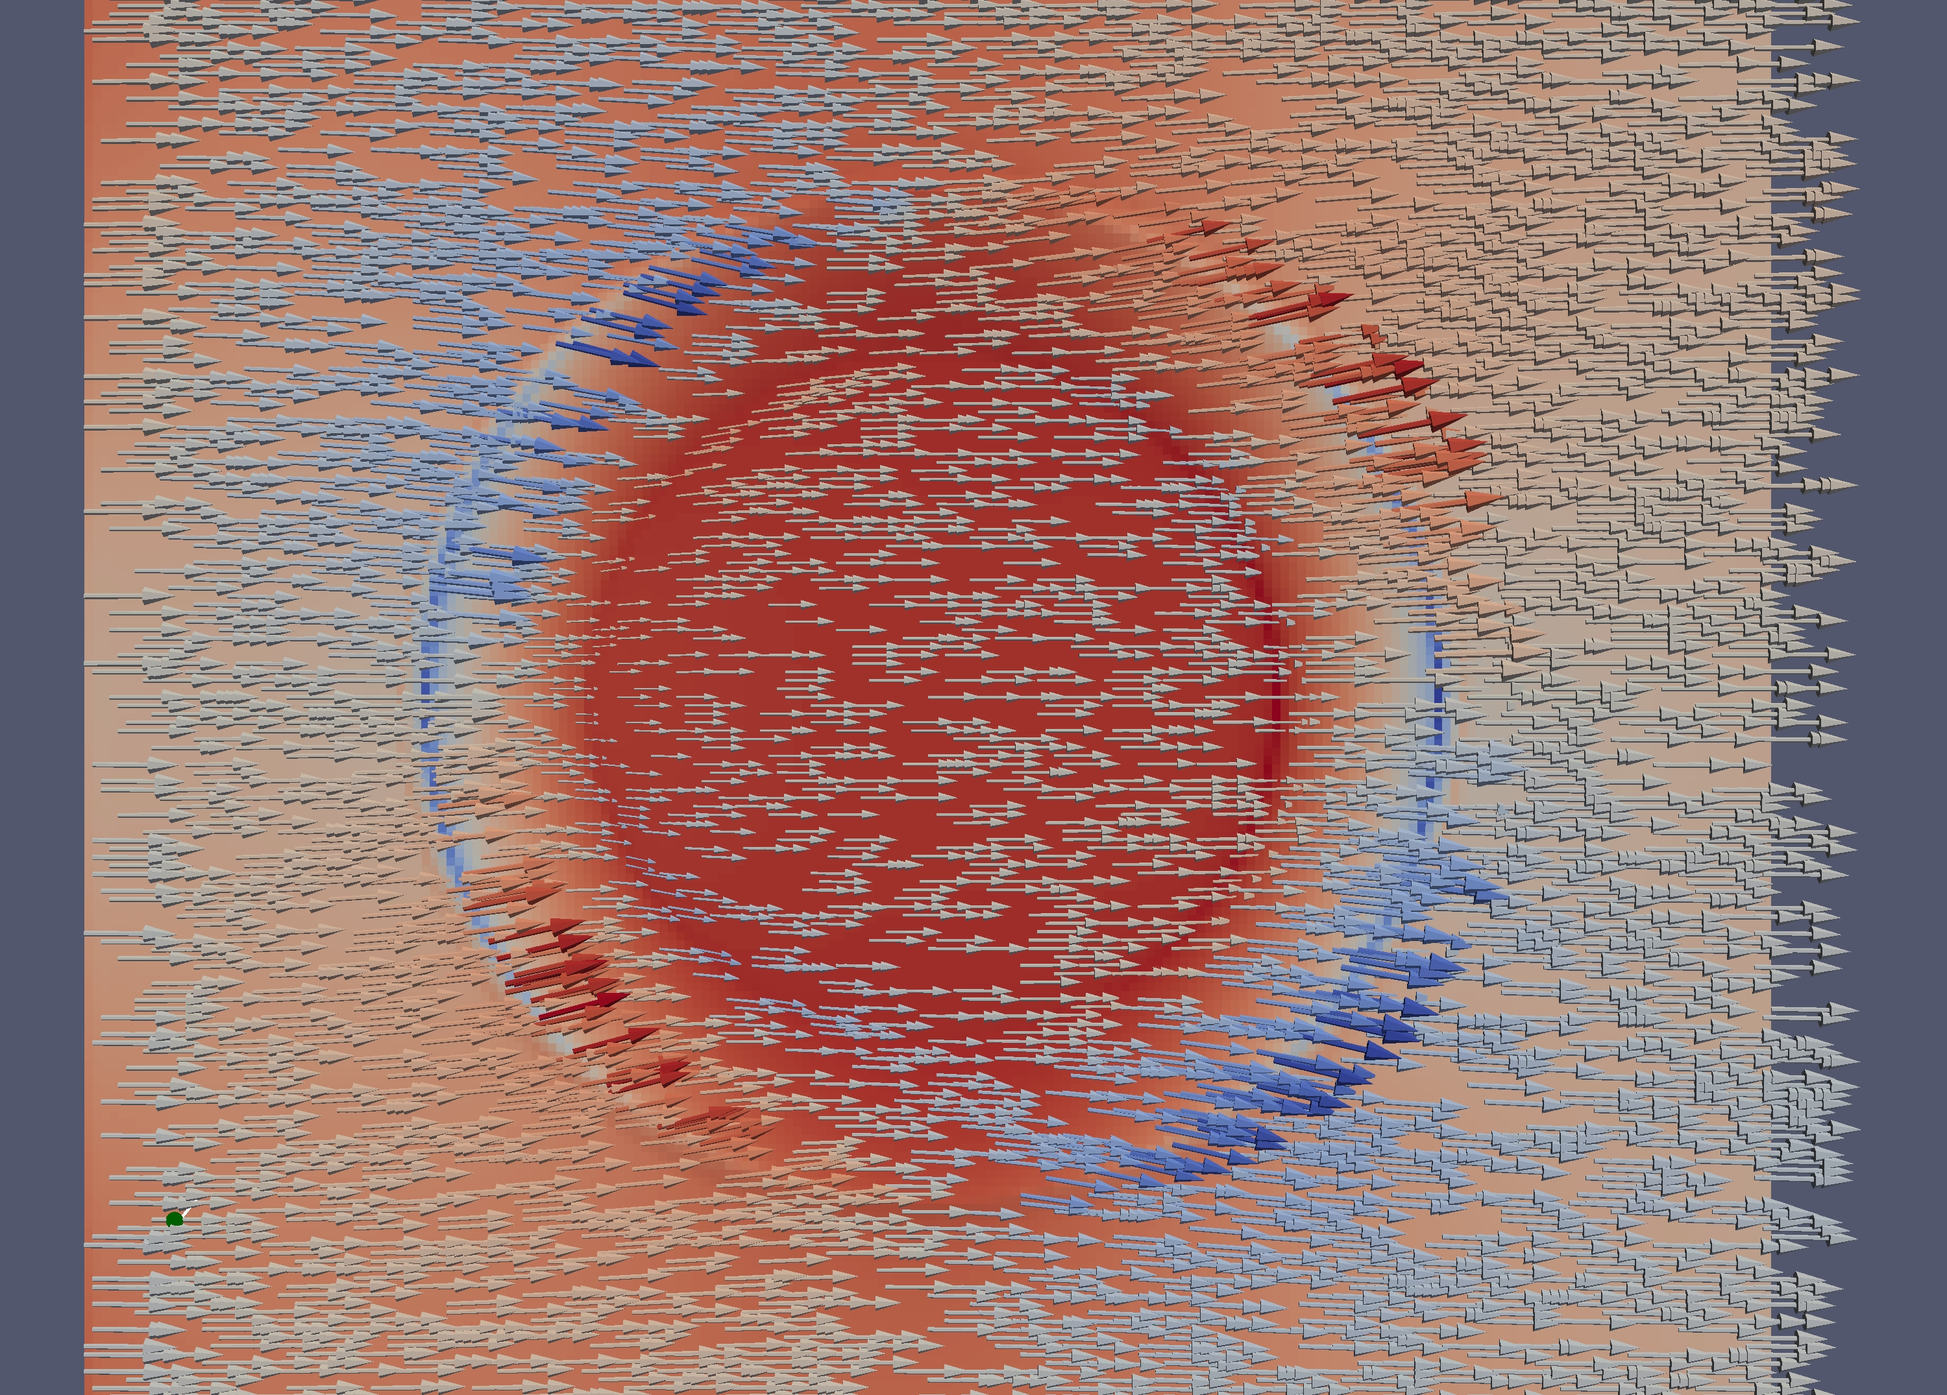
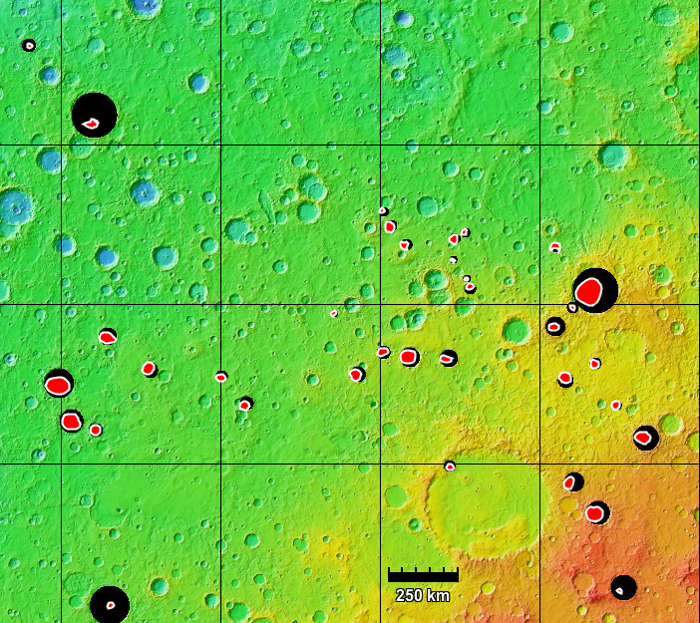
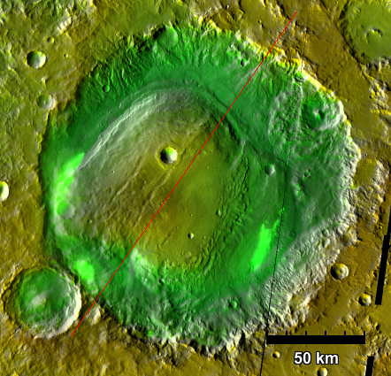
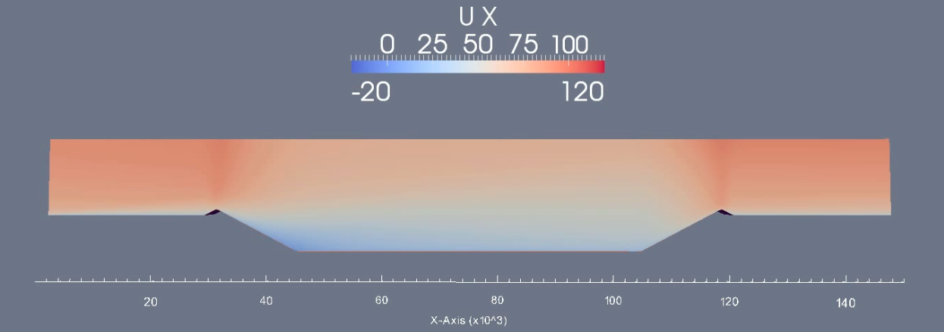
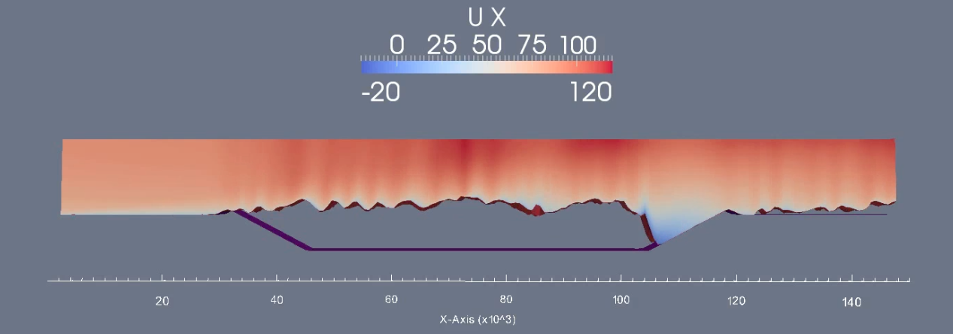
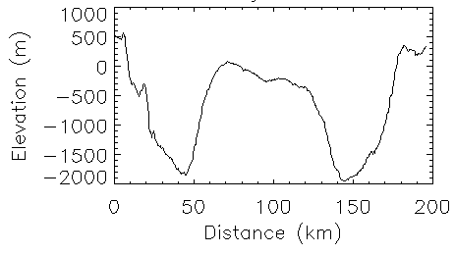
Martian Craters with Interior Deposits: Global Survey Results and Wind Model
P21D-1875
Kristen A. Bennett¹ and Mark Schmeeckle²
¹School of Earth and Space Exploration, Arizona State University; ²School of Geographical Sciences & Urban Planning, Arizona State University
Contact: Kristen.A.Bennett@asu.edu
Introduction
Results I: Global Survey
Results II: Wind Model
The Mars Science Laboratory rover is currently exploring Mt. Sharp, a 5 km high mound of sediments in Gale Crater¹
Mt. Sharp is proposed to be able to preserve evidence of life or evidence of past Martian habitability¹
There are many of these central mounds across Mars,² how does Mt. Sharp compare?
Mounds are hypothesized to form when a crater is completely filled with sediment which is then eroded²
The exact formation mechanism is unknown; proposed methods include subaqueous and subaerial processes^{2,3,4}
For an initial empty crater:
Fluid acceleration at the top of the rim creates a zone of low pressure that forces wind and sand over the rim into the crater, instead of around it.
Once the sand is forced into the crater, piles of sediment occur against the crater wall and the sediment continues to fill the entire crater
Figure 1: Global Survey of Central Mounds.
Background: MOLA elevation^{5,7}
Figure 5: Model run on a crater mesh. Background is pressure field, arrows are wind velocity, arrows are colored with wind y-velocity
Arabia Terra
85 total mounds
Northern Hemisphere: 38
Southern Hemisphere: 47
Western Arabia Terra: 35
Over 40% of all mounds
Mounds in Arabia Terra are preferentially offset to the western half of their crater
All other mounds do not appear to be offset
Methods
a)
b)
Global Survey
Identify central mounds in craters above 25 km in diameter from -60° to 60° latitude using MOLA⁵ global elevation map
Calculate their offset from the center of the crater
Figure 6: Cutaway view of the model results. a) Initial velocity field in the crater. b) Velocity field in the crater at the end of the simulation. Time step: ~300 years, end time: ~100,000 years
Figure 2: Arabia Terra with 35 craters (black) containing central mounds (red)⁷
Figure 3: Example of a central mound, Henry Crater⁷
Conclusions and Future Work
Wind Model
In each time iteration, calculate:
3-dimensional steady-state wind field by solving the Reynolds-averaged Navier-Stokes equation
Sediment flux field from saltation transport/dust erosion model
Surface elevation change based on sediment continuity equation (model does not allow erosion of bedrock)
Volumetric flow rate used:⁶
Where ρ_{f} is the mass density of the fluid, ρ_{s} is the mass density of the sediment, g is gravity, D is the particle diameter, and u* is the friction velocity.
Global Survey:
Globally, mound offsets appear random, however, in Arabia Terra the mounds are offset to the West
The offsets could be a result of unidirectional winds
The central mounds in Arabia Terra may be different from the rest of the population in terms of the formation mechanism, sediments, time of formation, etc. Scientists should use caution when comparing Arabia Terra mounds to Mt. Sharp in Gale Crater.
Future Work: Geomorphology and mineralogy study of mounds
Wind Model:
This works shows it could be possible for wind to completely infill craters with sediment, which would then be available for future erosion to form mounds
Future Work: Start with a crater filled with sediment to rim and use the model to test the hypothesis that crater mound geometry is a result of wind erosion.
Mound Offset from Center of Crater
a) All
Mounds
b) Arabia
c) No Arabia
85 mounds
35 mounds
50 mounds
Figure 4: Plots showing the offset of each mound from its crater center. The distance from the center is normalized by the crater radius. a) Offsets of all mounds b) Offsets of mounds in Arabia Terra c) Offsets of all mounds excluding Arabia Terra.
References
[1] Grotzinger, J. (2009) Beyond Water on Mars. Nature Geoscience. [2] Malin, M.C. and Edgett, K.S. (2000) Sedimentary Rocks of Early Mars, Science. [3] Andrews-Hanna, J.C. et al. (2010) Early Mars hydrology: Meridiani playa deposits and the sedimentary record of Arabia Terra. JGR, 115, E06002. [4] Fergason and Christensen (2008) Formation and erosion of layered materials: Geologic and dust cycle history of eastern Arabia Terra, Mars. JGR. [5] Zuber, M. T. et al. (1992) Mars Observer laser altimeter investigation. JGR, 97. [6] Creyssels, M. et al. (2009) Saltating particles in a turbulent boundary layer: experiment and theory. JFM, 625. [7] Christensen, P.R. et al. (2009) JMARS- A Planetary GIS. AGU Fall Meeting.

